Slide 1
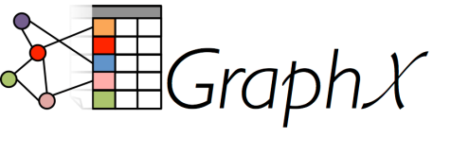
Introduction to Spark #5 GraphX: Graph Analytics on Spark
Srini Penchikala
srinipenchikala@gmail.com
08/06/14

Slide 2

About Me
Solutions Architect
Lead Editor for NoSQL at InfoQ.com
Started as a Java Developer
Current Focus: NoSQL Databases
Cassandra
MongoDB
Neo4j
Hazelcast
Not a Data Scientist

Slide 3
Sources for this presentation
Graph Analytics with Graphx** (https://databricks-training.s3.amazonaws.com/graph-analytics-with-graphx.html)
GraphX Programming Guide (http://spark.apache.org/docs/latest/graphx-programming-guide.html)
Spark Summit 2014 Presentations
AmpCamp 2014 Presentations

Slide 4
Software Used for Today’s Demos
Spark 1.0.1
JDK 1.6 (http://www.oracle.com/technetwork/java/javase/downloads/index-jsp-138363.html)
Scala IDE in Eclipse
Windows

Slide 5
How to Install Spark
Spark 1.0.1 (https://spark.apache.org/downloads.html)
Cloudera VM (http://www.cloudera.com/content/support/en/downloads/quickstart_vms/cdh-5-1-x.html)
Vagrant/VirtualBox/Chef
Others?

Slide 6
How to run Spark
Four ways to run Spark
Run Spark locally with one worker thread(no parallelism)
spark-shell.cmd or spark-shell.cmd local
Run locally with K worker threads (ideally set to # of cores)
spark-shell.cmd local[2]
Connect to a Spark standalone cluster
spark-shell.cmd spark://HOST:PORT
Example: MASTER=spark://localhost:7077
Connect to a Mesos cluster
spark-shell.cmd mesos://HOST:PORT

Slide 7
Agenda
Spark
GraphX
Use Cases
Demos
Q&A

Slide 8
Spark

Slide 9
Spark Background
Distributed Systems are the new standard (specifically, Data Parallel systems)
Spark: An SDK for Big Data Applications
Unified System With Libraries to Build a Complete Solution
Full-featured Programming Environment
Single, Consistent Interface for Developers to Write Against
Runtimes available on several platforms

Slide 10
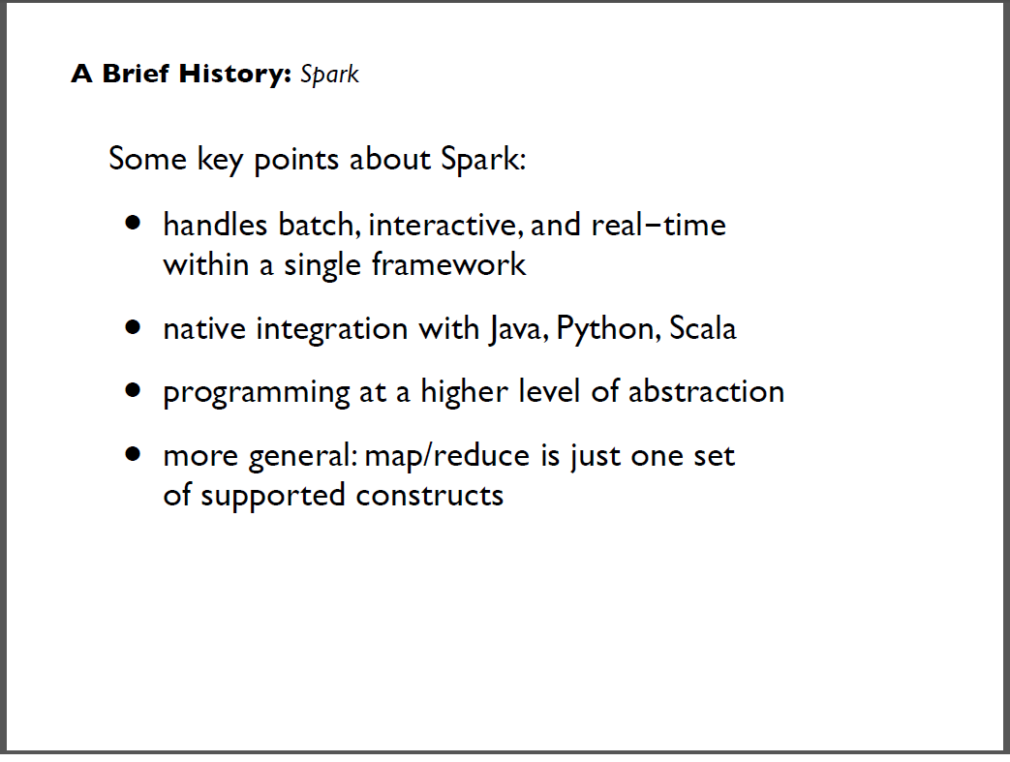

Slide 11
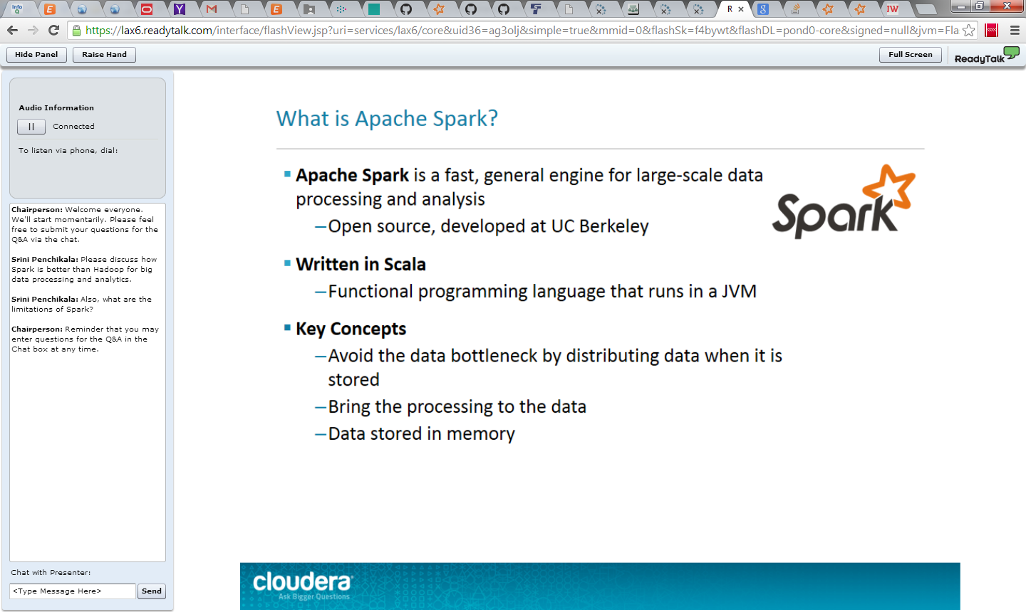

Slide 12
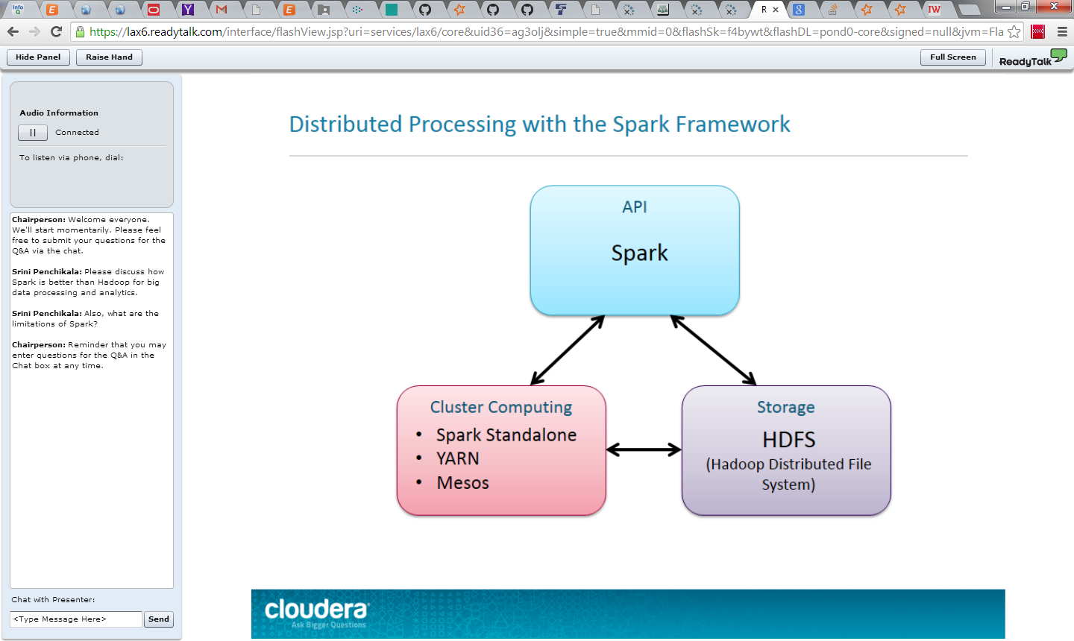

Slide 13
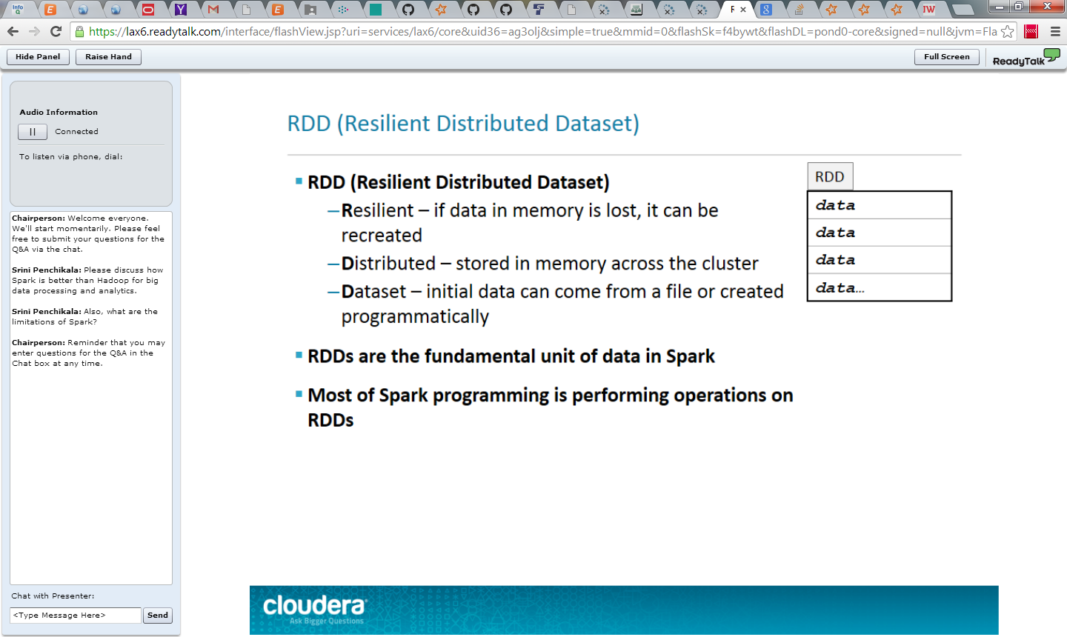

Slide 14
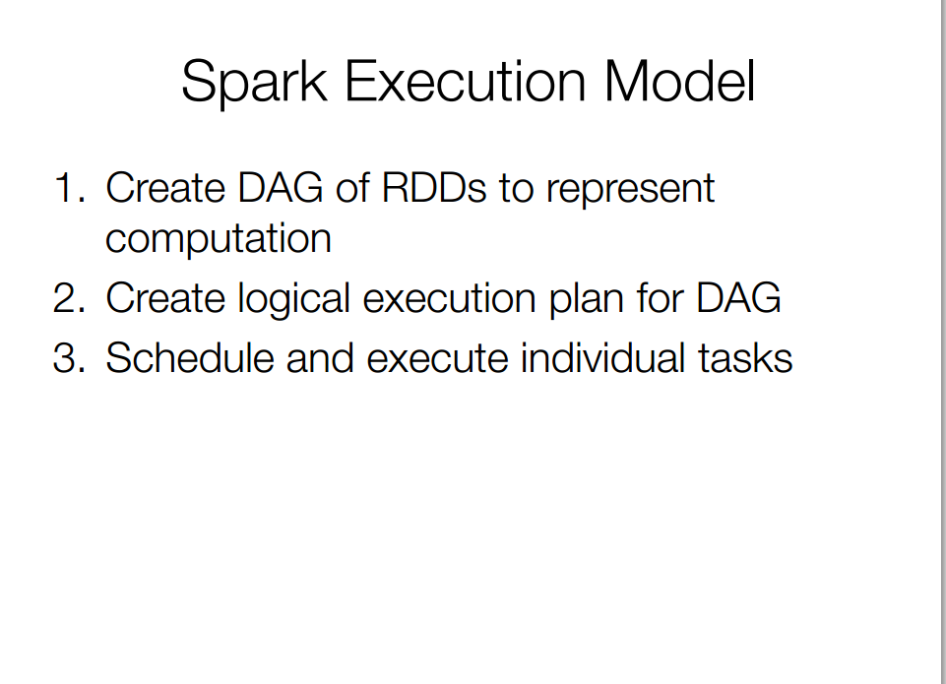

Slide 15
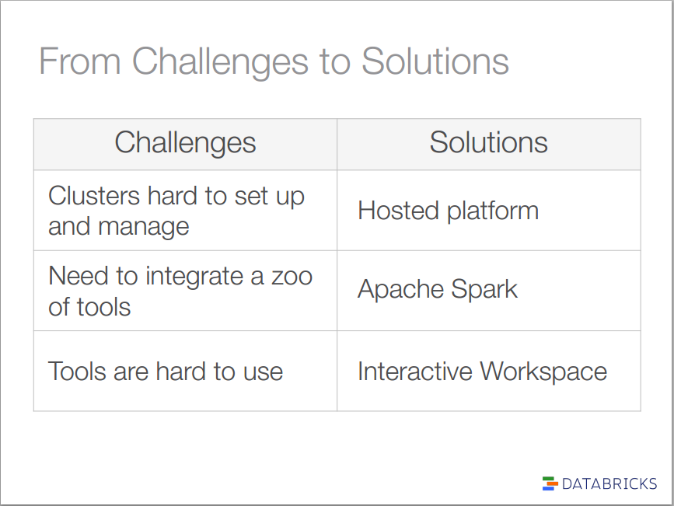

Slide 16
GraphX

Slide 17
What is GraphX
New Spark API for:
Graphs (e.g., Web-Graphs and Social Networks)
Graph-parallel computation (e.g., PageRank and Collaborative Filtering)
Extends Spark RDD
Resilient Distributed Property Graph
Resilient Distributed Property Graph:
http://spark.apache.org/docs/latest/api/scala/index.html#org.apache.spark.graphx.Graph

Slide 18
Property Graphs
Property Graph: directed multi-graph with properties attached to each vertex and edge
Like RDDs, property graphs are immutable, distributed, and fault-tolerant.

Slide 19
GraphX Components
Set of operators (e.g., subgraph, joinVertices, & mapReduceTriplets)
Graph algorithms
PageRank
Connected Components
Triangle Counting
Graph Builders to simplify graph analytics tasks

Slide 20
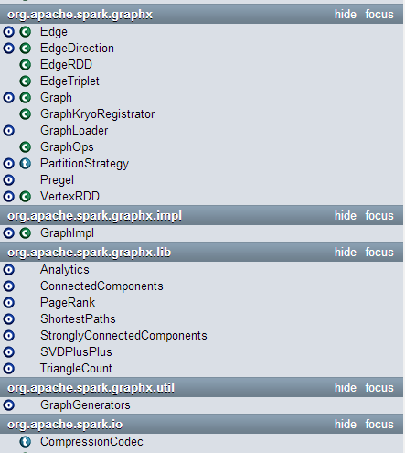
GraphX – Current Status
Currently only available in Scala
GraphX API
Java and Python bindings (future)
GraphX API Link:
http://spark.apache.org/docs/latest/api/scala/index.html#org.apache.spark.graphx.package

Slide 21
Graph Algorithms
PageRank
Connected Components
Triangle Counting Example

Slide 22
Graphs are Central to Analytics
Hyperlinks
PageRank
Top 20 Pages
Raw
Wikipedia
Text
Table
Title
PR
< / >
Title
Body
Term-Doc
Graph
Topic Model
(LDA)
< / >
< / >
Word Topics
XML
Word
Topic
Discussion
Table
Community
Detection
User
Community
Community
Topic
Editor Graph
User
Disc.
User
Com.
Topic
Com.

Slide 23
Graphs are Central to Analytics
Hyperlinks
PageRank
Top 20 Pages
Raw
Wikipedia
Text
Table
Title
PR
< / >
Title
Body
Term-Doc
Graph
Topic Model
(LDA)
< / >
< / >
Word Topics
XML
Word
Topic
Discussion
Table
Community
Detection
User
Community
Community
Topic
Editor Graph
User
Disc.
User
Com.
Topic
Com.

Slide 24
Graphs are Essential to Data Mining and Machine Learning
Identify influential people and information
Find communities
Understand people’s shared interests
Model complex data dependencies

Slide 25










Recommending Products
Users
Ratings
Items

Slide 26
Recommending Products
Low-Rank Matrix Factorization:
f(3)
r₁₃
Movies
f(1)
Netflix
≈
x
Users
Users
f(j)
r₁₄
f(4)
f(i)
User Factors (U)
Movie Factors (M)
r₂₄
f(2)
Movies
r₂₅
f(5)
Iterate:

Slide 27






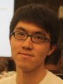



Collaborative Filtering
Users
Ratings
Items

Slide 28



Predicting User Behavior
?
?
Liberal
Conservative
?
?
?
?
?
?
?
?
Post
?
Post
?
Post
Post
?
Post
Post
Post
Post
?
Post
Post
Post
Post
?
Post
?
Post
?
?
?
?
?
Post
?
Post
Post
Post
Conditional Random Field
Belief Propagation
Post
Post
Post
?
Post
?
?
?
?
?
?
?

Slide 29
Finding Communities
Count triangles passing through each vertex:
Measures “cohesiveness” of local community
2
3
1
4
Fewer Triangles
Weaker Community
More Triangles
Stronger Community

Slide 30
Many More Graph Algorithms
Collaborative Filtering
Alternating Least Squares
Stochastic Gradient Descent
Tensor Factorization
SVD
Structured Prediction
Loopy Belief Propagation
Max-Product Linear Programs
Gibbs Sampling
Semi-supervised ML
Graph SSL
CoEM
Graph Analytics
PageRank
Single Source Shortest Path
Triangle-Counting
Graph Coloring
K-core Decomposition
Personalized PageRank
Classification
Neural Networks
Lasso
…

Slide 31



Example Graph Analytics Pipeline
Preprocessing
Compute
Post Proc.
< / >
< / >
< / >
XML
Raw
Data
ETL
Slice
Compute
Analyze
Initial
Graph
Subgraph
PageRank
Top
Users
Repeat

Slide 32



Separate Systems to Support Each View
Table View
Graph View
Pregel
Table
Dependency Graph
Row
Row
Result
Row
Row
Notes:
----- Meeting Notes (1/5/14 14:58) -----
Spark too.

Slide 33
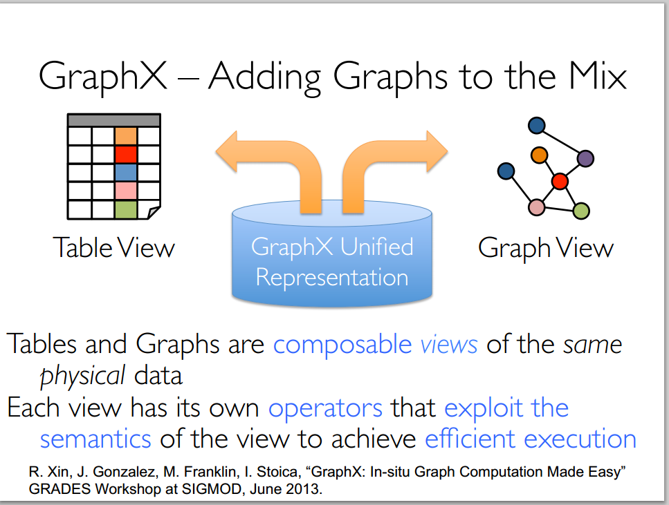

Slide 34
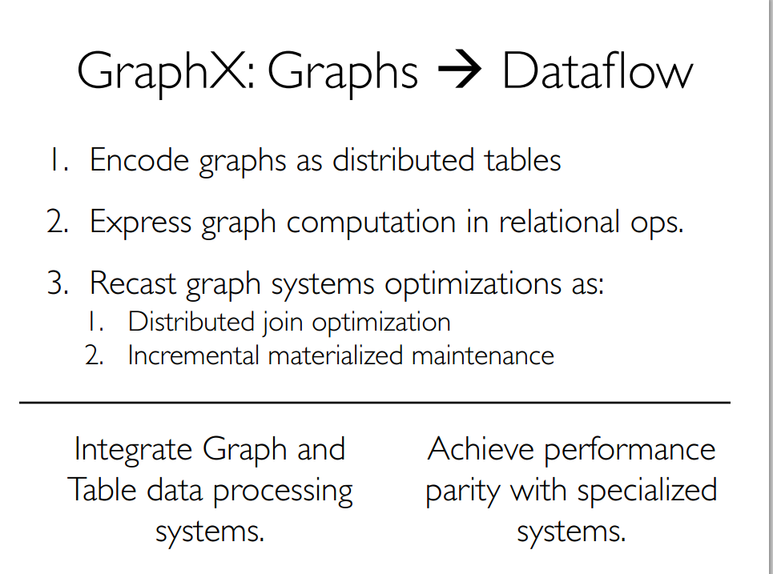

Slide 35
Having separate systems for each view is difficult to use and inefficient

Slide 36

Difficult to Program and Use
Users must Learn, Deploy, and Manage multiple systems
Leads to brittle and often complex interfaces

Slide 37
Inefficient
Extensive data movement and duplication across the network and file system
< / >
< / >
< / >
XML
HDFS
HDFS
HDFS
HDFS
Limited reuse internal data-structures across stages

Slide 38
Solution: The GraphX Unified Approach
New API
Blurs the distinction between Tables and Graphs
New System
Combines Data-Parallel Graph-Parallel Systems
Enabling users to easily and efficiently express the entire graph analytics pipeline

Slide 39
Tables and Graphs are composable views of the same physical data
GraphX Unified
Representation
Table View
Graph View
Each view has its own operators that exploit the semantics of the view
to achieve efficient execution
Notes:
and users can move between views without copying or moving data

Slide 40
View a Graph as a Table
Vertex Property Table
Property Graph
Id
Rxin
Jegonzal
Franklin
Istoica
Property (V)
(Stu., Berk.)
(PstDoc, Berk.)
(Prof., Berk)
(Prof., Berk)
R
F
Edge Property Table
SrcId | DstId
rxin | jegonzal
franklin | rxin
istoica | franklin
franklin | jegonzal
Property (E)
Friend
Advisor
Coworker
PI
J
I

Slide 41
Distributed Graphs as Tables (RDDs)
Vertex Table (RDD)
Routing
Table (RDD)
Edge Table
(RDD)
Property Graph
Part. 1
A
B
B
A
A
1
2
B
C
C
A
C
B
B
1
B
C
C
D
A
A
A
D
D
D
C
C
1
2D Vertex Cut Heuristic
A
D
Part. 2
A
E
D
D
1
2
A
F
F
F
E
E
E
E
2
E
D
F
F
2
E
F

Slide 42
By exploiting graph-structure Graph-Parallel systems can be orders-of-magnitude faster.

Slide 43
Triangle Counting on Twitter
40M Users, 1.4 Billion Links
Counted: 34.8 Billion Triangles
Hadoop [WWW’11]
1536 Machines
423 Minutes
64 Machines
15 Seconds
1000 x Faster
GraphLab
S. Suri and S. Vassilvitskii, “Counting triangles and the curse of the last reducer,” WWW’11

Slide 44



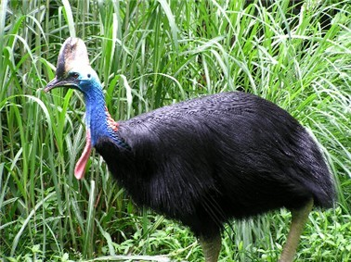

Specialized Graph Systems
Pregel

Slide 45
Specialized Graph Systems
APIs to capture complex graph dependencies
Exploit graph structure to reduce communication and computation

Slide 46
Why GraphX?

Slide 47
The Bigger Picture
Post
Proc.
Hadoop Graph Algorithms
Graph Lab
Graph Creation
Time Spent in Data Pipeline

Slide 48
GraphX Unifies Data-Parallel and Graph-Parallel Systems
Spark Table API
RDDs, Fault-tolerance, and task scheduling
GraphLab Graph API
graph representation and execution
one system for the entire graph pipeline
Graph Construction
Computation
Post-Processing

Slide 49
Enable Joining Tables and Graphs
ETL
Join
Inf.
User
Data
Friend Graph
Product Rec.
Graph
Prod.
Rec.
Tables Graphs
Product
Ratings

Slide 50
The GraphX Resilient Distributed Graph
Id
Rxin
Jegonzal
Franklin
Istoica
Attribute (V)
(Stu., Berk.)
(PstDoc, Berk.)
(Prof., Berk)
(Prof., Berk)
R
F
J
I
SrcId | DstId
rxin | jegonzal
franklin | rxin
istoica | franklin
franklin | jegonzal
Attribute (E)
Friend
Advisor
Coworker
PI

Slide 51
Table Operators
Table (RDD) operators are inherited from Spark:
map
filter
groupBy
sort
union
join
leftOuterJoin
rightOuterJoin
reduce
count
fold
reduceByKey
groupByKey
cogroup
cross
zip
sample
take
first
partitionBy
mapWith
pipe
save
...

Slide 52
GraphX API
class Graph [ V, E ] {
// Table Views -----------------
def vertices: RDD[ (Id, V) ]
def edges: RDD[ (Id, Id, E) ]
def triplets: RDD[ ((Id, V), (Id, V), E) ]
// Transformations ------------------------------
def reverse: Graph[V, E]
def filterV(p: (Id, V) => Boolean): Graph[V,E]
def filterE(p: Edge[V,E] => Boolean): Graph[V,E]
def mapV[T](m: (Id, V) => T ): Graph[T,E]
def mapE[T](m: Edge[V,E] => T ): Graph[V,T]
// Joins ----------------------------------------
def joinV[T](tbl: RDD[(Id, T)]): Graph[(V, Opt[T]), E ]
def joinE[T](tbl: RDD[(Id, Id, T)]): Graph[V, (E, Opt[T])]
// Computation ----------------------------------
def aggregateNeighbors[T](mapF: (Edge[V,E]) => T, reduceF: (T, T) => T, direction: EdgeDir): Graph[T, E]
}

Slide 53
PageRank Performance
Notes:
54 GB Wikipedia dataset

Slide 54
Other Iterative Algorithms
Time per Iteration (s)
Notes:
100 GB datasets

Slide 55
Performance Comparisons
Live-Journal: 69 Million Edges
GraphX is roughly 3x slower than GraphLab

Slide 56
GraphX scales to larger graphs
Twitter Graph: 1.5 Billion Edges
GraphX is roughly 2x slower than GraphLab
Scala + Java overhead: Lambdas, GC time, …
No shared memory parallelism: 2x increase in comm.

Slide 57
PageRank is just one stage…. What about a pipeline?

Slide 58
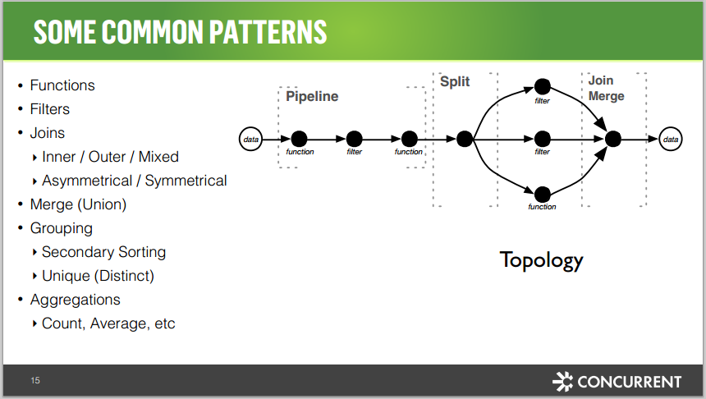

Slide 59
A Small Pipeline in GraphX
Raw Wikipedia
Hyperlinks
PageRank
Top 20 Pages
< / >
< / >
< / >
HDFS
HDFS
XML
Spark Preprocess
Compute
Spark Post.
605
375
Timed end-to-end GraphX is faster than GraphLab
Notes:
Also faster in human time but it is hard to measure.

Slide 60
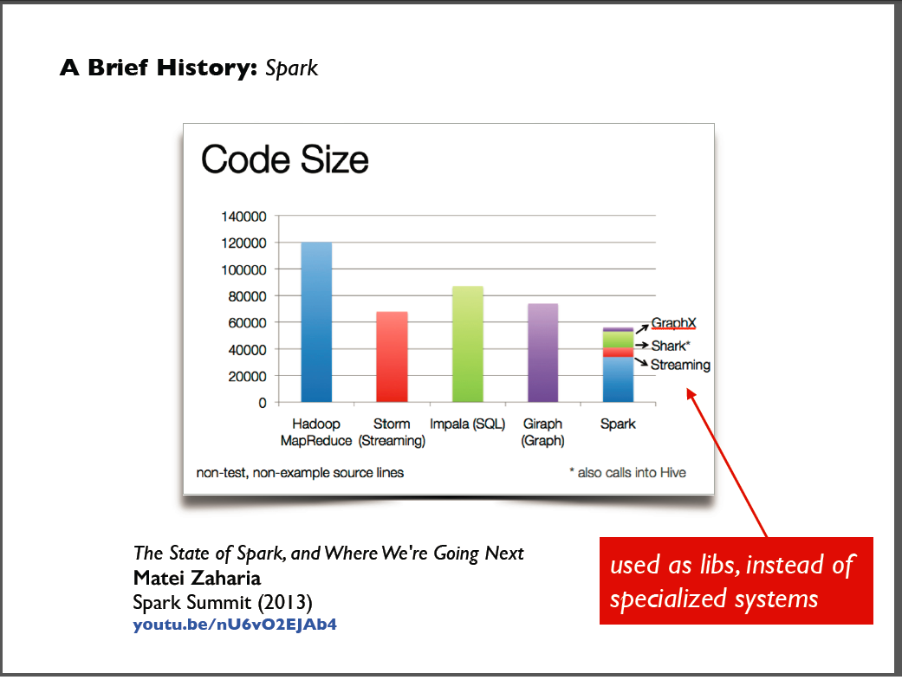
Spark v Hadoop - Code Size

Slide 61
The GraphX Stack (Lines of Code)
PageRank (5)
Connected Comp. (10)
Shortest Path (10)
SVD
(40)
ALS
(40)
K-core
(51)
Triangle
Count
(45)
LDA
(120)
Pregel (28) + GraphLab (50)
GraphX (3575)
Spark

Slide 62
Graph Analytics Code Example

Slide 63
Code Example – Use Case
Use Case:
Use GraphX to analyze Wikipedia data and implement graph algorithms in Spark.
Data Sets:
Articles (Nodes/Vertices): graphx-wiki-vertices.txt
Links to articles (Edges/Relationships): graphx-wiki-edges.txt

Slide 64
Code Example Steps
Import Spark GraphX API
Load Article data from text file into RDD
Load Links data from text file into RDD
Construct the Graph using the two datasets
Parse article rows into pairs of vertex ID and title
Parse link rows into Edge objects with placeholder 0 attribute
Create graph by calling Graph constructor with vertex RDD, our edge RDD & default vertex attribute
Cache the resulting graph in memory to avoid reloading it from disk each time we use it
Verify the data created so far

Slide 65
Code Example Steps - 2
Run graph analytics**
Run PageRank on Wikipedia
Find titles of ten most important articles in Berkeley subgraph of Wikipedia

Slide 66
Demo

Slide 67
Serialization
GraphX requires Kryo serializer to achieve maximum performance
spark.serializer property in Spark UI
By default Kryo Serialization is not enabled
Enable Kryo Serialization for the spark shell
Set Serialization setting in "spark-shell.cmd" file

Slide 68
Demo with Serialization

Slide 69
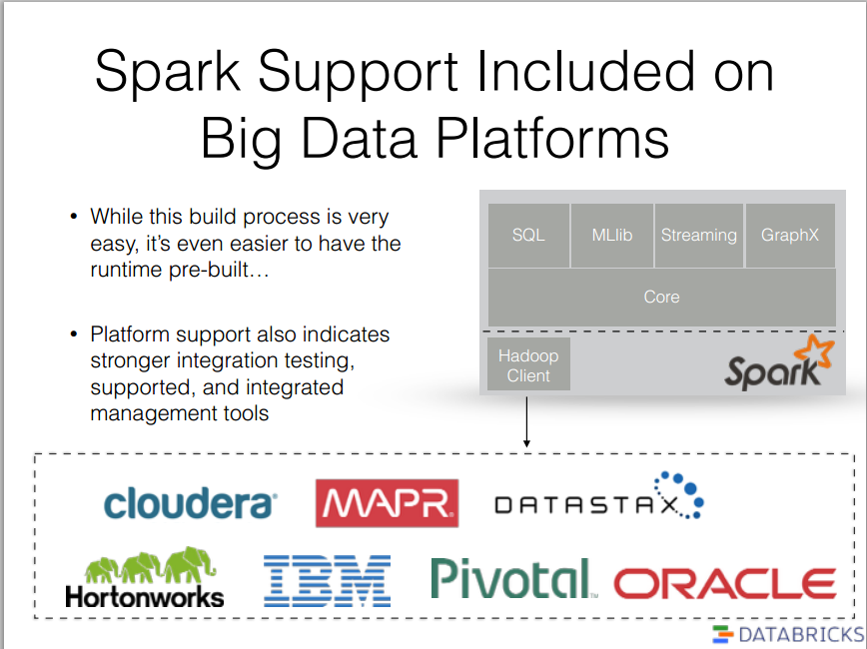
Spark Distro Platforms
http://spark.apache.org/docs/latest/hadoop-third-party-distributions.html

Slide 70

Conclusions

Slide 71
Spark and GraphX Resources
Spark:
Spark Main Site (http://spark.apache.org/docs/latest/index.html)
Spark Summit 2014 Conference (http://spark-summit.org/2014)
Spark Configuration (http://spark.apache.org/docs/latest/configuration.html)
Tuning Spark (http://spark.apache.org/docs/latest/tuning.html)
Monitoring and Instrumentation (http://spark.apache.org/docs/latest/monitoring.html)
Spark Overview ("Where to Go from Here" section) (http://spark.apache.org/docs/latest/index.html)
API Docs:
Scala (http://spark.apache.org/docs/latest/api/scala/index.html#org.apache.spark.package)
Java (http://spark.apache.org/docs/latest/api/java/index.html)
Python (http://spark.apache.org/docs/latest/api/python/index.html)
GraphX:
Graph Analytics with Graphx (https://databricks-training.s3.amazonaws.com/graph-analytics-with-graphx.html)
GraphX Programming Guide (http://spark.apache.org/docs/latest/graphx-programming-guide.html)
GraphX on Github (http://amplab.github.io/graphx/)

Slide 72
Speaker Contact Information
InfoQ Lead Editor: http://www.infoq.com/author/Srini-Penchikala
Email: srinipenchikala@gmail.com
LinkedIn: http://linkedin.com/in/SriniPenchikala
Twitter: @srinip
Interested in writing articles for InfoQ?
Send an email to: srini@infoq.com

Slide 73
Q&A Questions & Comments

